Slide 1

Get serious . . . about automation.

Slide 2
The command line is fun for keyboard junkies.
Add %COMPOSABLE_BATCH_FILES% to you environment variables and path.
To see a list of the primary CBF batch files and their functions, type: C:\>cbf or m list

Slide 3
Get help.
To see the available functions for a batch file use the “/?” parameter.
For example, to get help (run these now):
c:\>m /?
c:\td /?
c:\>no /?

Slide 4

Some trivial examples to try . . .
C:\>td temp Navigates to the user’s temp directory in DOS.
C:\>of projects Opens the SAME folder as above except in Windows Explorer.
C:\>of cd Opens current DOS directory in Windows Explorer.
C:\>g s Show BitBucket status for current folder repositories INCLUDES online repository status comparison. I use this a lot.
C:\>c Clears the screen and resets the prompt color.

Slide 5
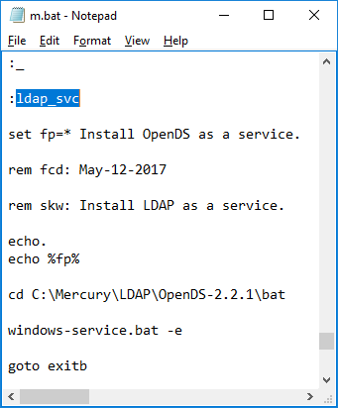
Need more info?
Running C:\>no m
Uses Notepad to open the mercury helper.bat file.
Search for the label, for instance “ladp_svc”,
and you can see the code I ran to install ldap
as a service, which be ran any time by entering
c:\>m ldap_svc

Slide 6
Scalable Self-Documenting Scripting
A cool thing about this architecture is that it is scalable in the sense that if you want some new script feature all you need to do is add a unique label and a code block and you are up and running.

Slide 7

The End (with a batch file of course) c:\sf clcr

